Slide 1

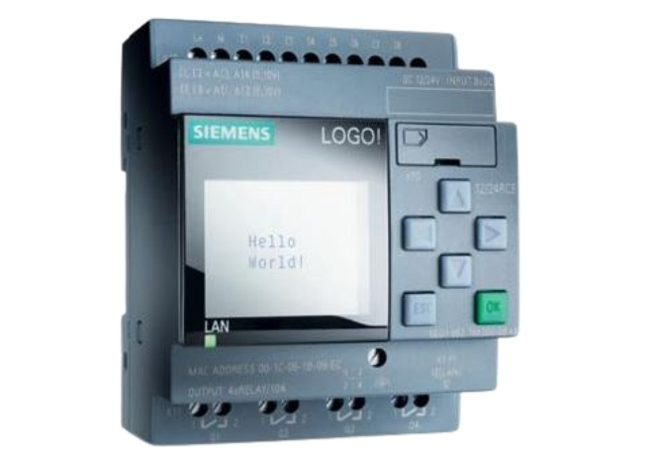
Programmable
Logic
Controllers
Introduction
In this lesson, we will delve into the topic of Programmable Logic Controllers (PLCs) and gain a comprehensive understanding of their overview and functionality.

Slide 2
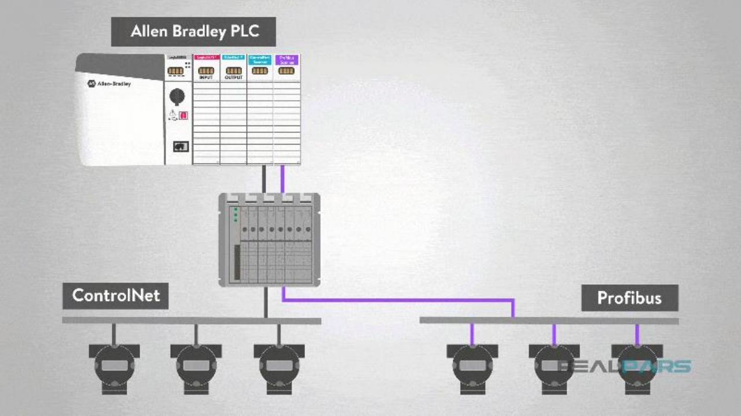

Slide 3
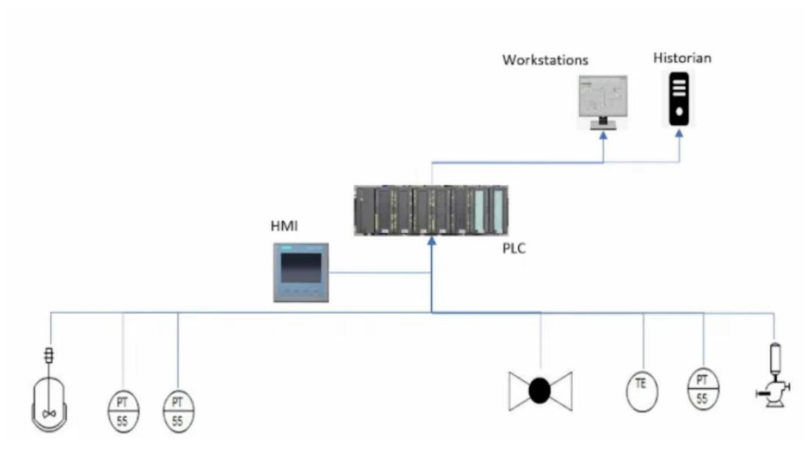

Slide 6
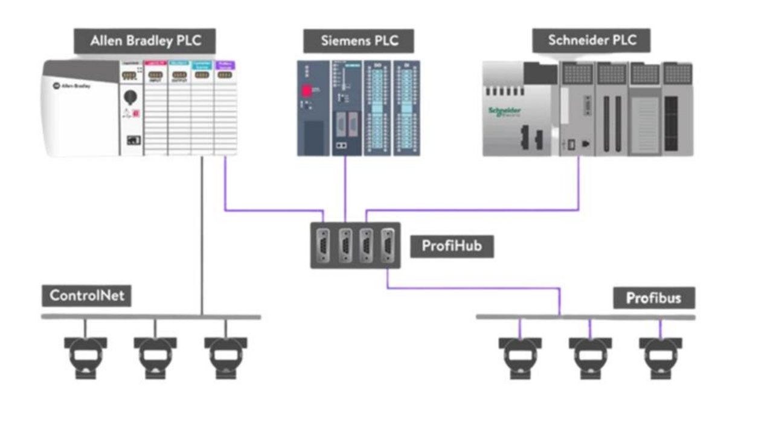

Slide 7
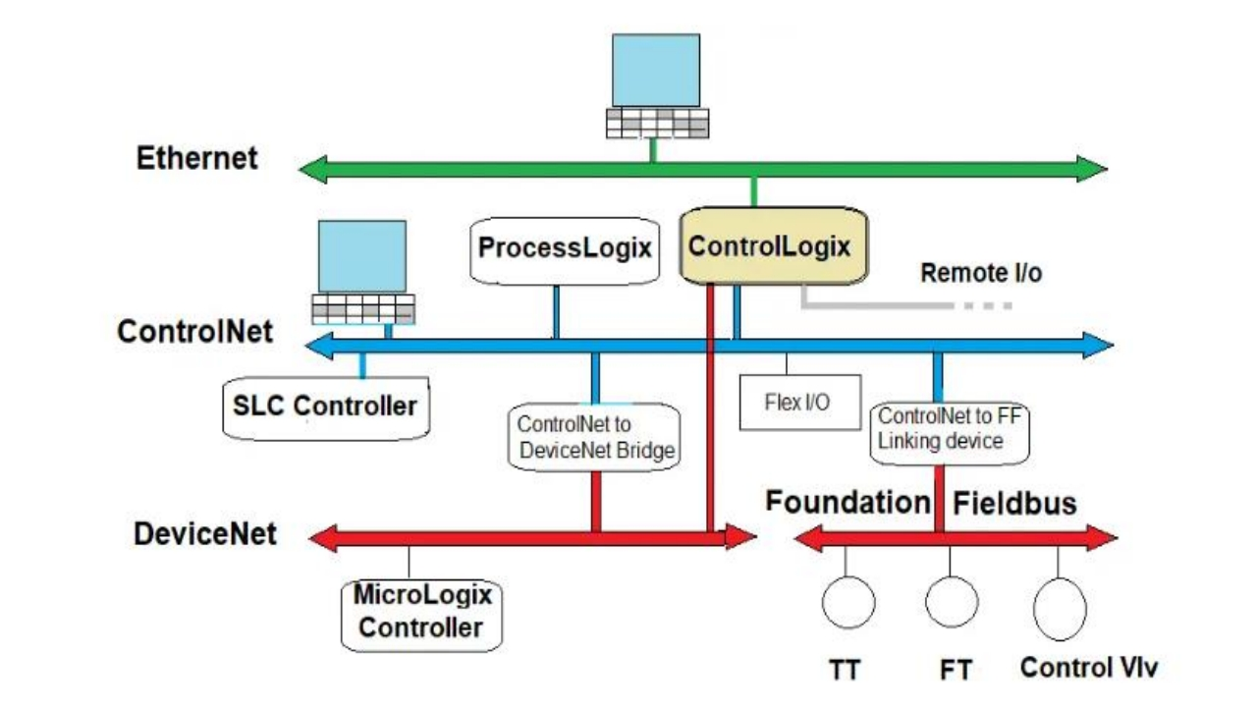

Slide 8
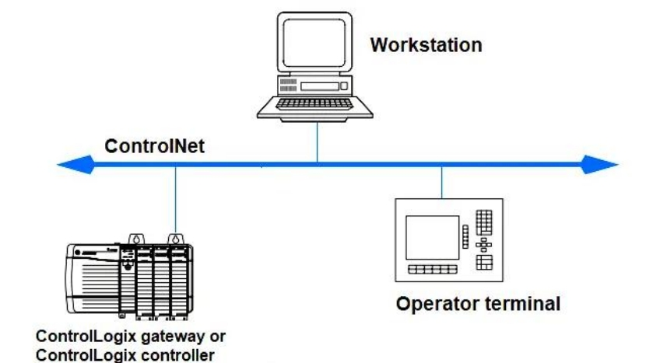
ControlNet

Slide 9
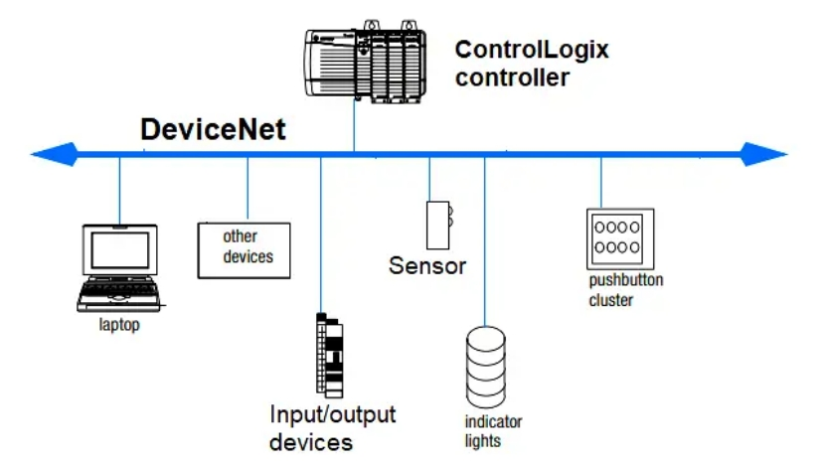
DeviceNet

Slide 10
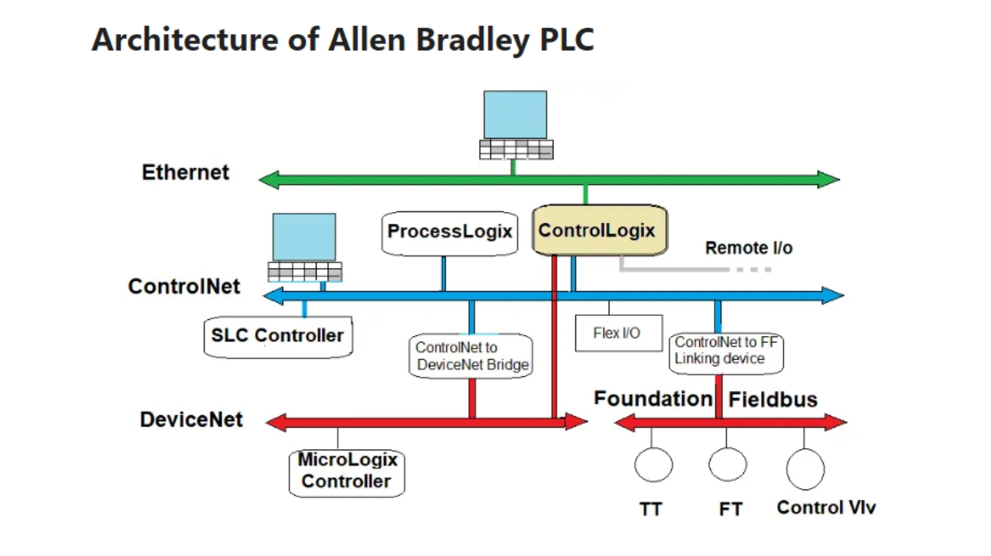

Slide 11
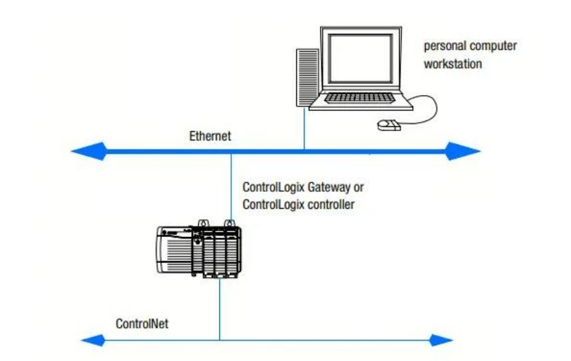
Ethernet
Network

Slide 12
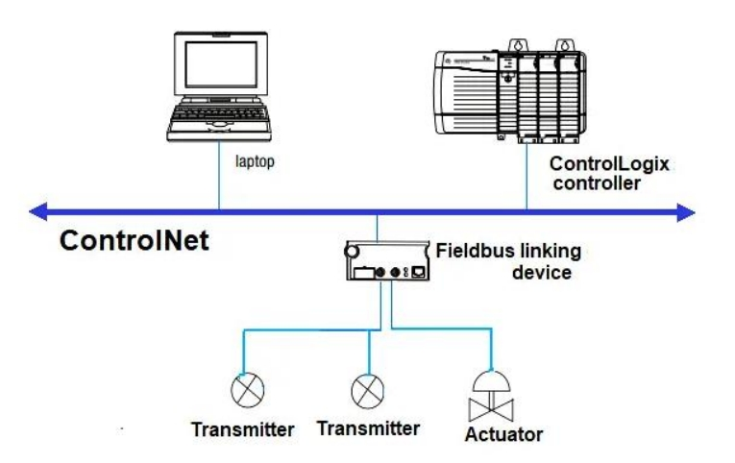
Fieldbus
Network

Slide 13

Communication Networks

Slide 14
PLCs are crucial for industrial automation and communicate with field devices.
PLC networks can be complex, connecting multiple systems in an industrial facility.
Wrap
Different PLC architectures offer flexibility for various control types.
Up
Communication networks facilitate data exchange in PLC networks.
Future lessons will explore PLC networks and cybersecurity.

